Slide 1

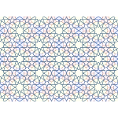
Prophetic Wisdom & Scientific Inquiry
Authentic Hadith as a Framework for Modern Reasoning

Slide 2


Deconstructing the Myth
The Misconception
The Prophetic Model
Modern narratives often present "Faith" as purely mystical and internal, while "Science" is strictly rational and external. This binary suggests they cannot coexist in one logical framework.
The Prophet (SAW) didn't just teach what to believe; he modeled how to process the world through observation, inquiry, and evidence-based reasoning as a spiritual duty.

Slide 3

Pillar 1
Empiricism vs. Superstition
Establishing Objective Causality

Slide 4
Evidence Over Emotion
إِنَّ الشَّمْسَ وَالْقَمَرَ آيَتَانِ مِنْ آيَاتِ اللَّهِ، لاَ يَنْخَسِفَانِ لِمَوْتِ أَحَدٍ وَلاَ لِحَيَاتِهِ
"The sun and the moon are two of the signs of Allah. They do not eclipse because of the death or life of someone. When you see them, invoke Allah and pray."
— Sahih al-Bukhari 1043 (Narrated on the day his son Ibrahim died)

Slide 5
Mapping to Objectivity
100%
OBJECTIVE CAUSALITY
Rejecting False Correlation
By decoupling a major celestial event (eclipse) from a deeply personal emotional loss (the death of his son), the Prophet (SAW) established the Scientific Law of Causality.
This is the core of scientific thinking: rejecting subjective myths in favor of universal physical laws established by the Creator.

Slide 6
Pillar 2
Falsifiability & Trial
The Autonomy of Worldly Knowledge

Slide 7
Practical Results are Data
أَنْتُمْ أَعْلَمُ بِأَمْرِ دُنْيَاكُمْ
"You have better knowledge (of a technical skill) in the affairs of your world."
— Sahih Muslim 2363 (Regarding the pollination of date palms in Medina)

Slide 8


The Methodology of Iteration
Expert Autonomy
When his suggestion for a change in pollination yielded less fruit, he deferred to the farmers' experience. This demonstrates Falsifiability: the willingness to test a hypothesis and change based on results.
He separated Divine Revelation (eternal truth) from Worldly Experimentation (iterative data), giving the "green light" for scientific specialization.

Slide 9
Pillar 3
Systematic Medicine
The Call for Inductive Reasoning

Slide 10
The Foundation of Research
"There is no disease that Allah has created, except that He also has created its treatment.“
Source: Sahih al-Bukhari, Vol. 7, Book 71, Hadith 582 (trans. 1997).

Slide 11






The Foundation of Research
Inductive Logic
Search for Cures
Legacy of Care
"There is no disease that Allah has created, except that He also has created its treatment." (Bukhari 5678)
By asserting a cure exists, he created the philosophical mandate for centuries of Muslim medical research.
This shifted medicine from superstition/magic to a systematic, peer-reviewed pursuit of remedies.

Slide 12
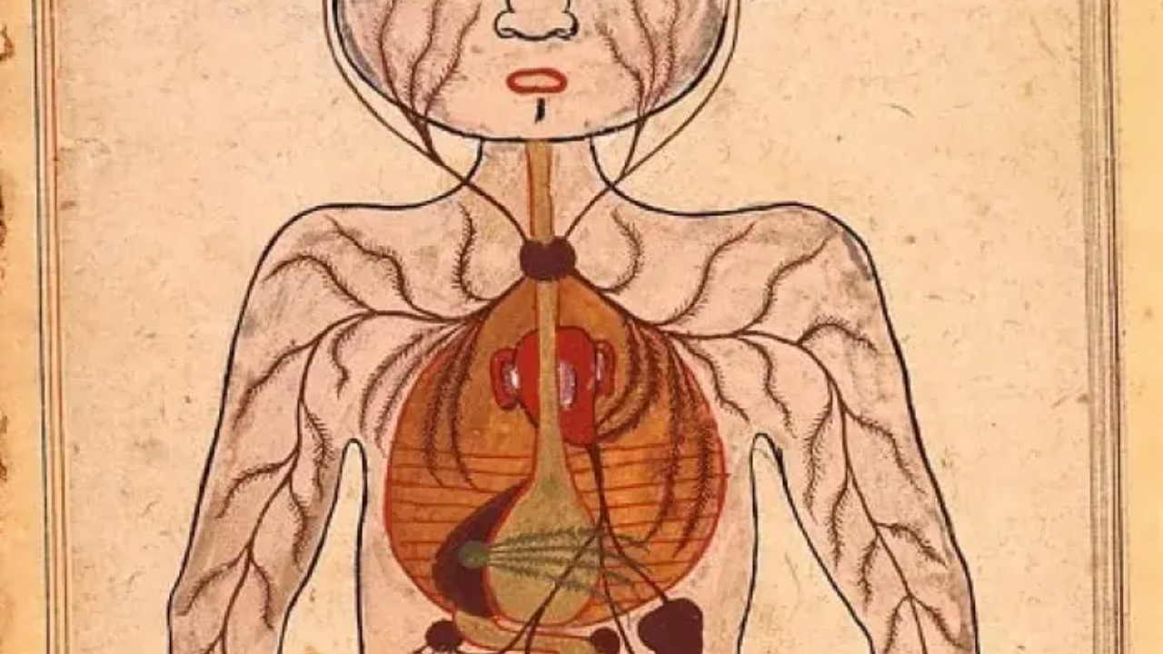


Curiosity as Ibadah
Scientific thinking isn't an "add-on" to faith; it is baked into the Prophetic requirement to "read" and "reflect" on the universe. The Prophet (SAW) didn't just give answers; he taught a framework for asking better questions.

Slide 13
Additional Pillars
Prohibition of ‘Ghilah’ (copulation with breastfeeding mothers) - Sunan an-Nasa'ie
The Battle of the Trench - Ar-Raheeq Al-Makhtum
Determining the Start and End of Ramadan - Sahih Bukhari, Volume 3, Book 31, Hadith 133.

Slide 14
Questions?
Exploring the Intersection of Reason and Revelation

